Slide 1
behaviour session
Wednesday 24th April 2024

Slide 2
Agenda
Research
The foundations of our approach
School rules
Non-negotiables
Focusing on best conduct
Restorative process
Questions and answers

Slide 3
What is our approach to behaviour at georgeham?
Paul Dix – When the adults changes, everything changes
Crisis Prevention Institute
Behaviour as communication
Safeguarding

Slide 4
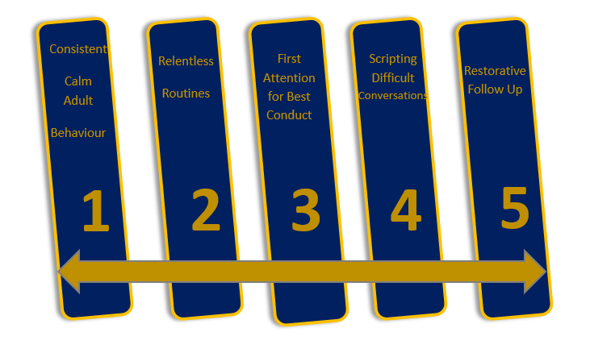
The foundations of our approach

Slide 5
School rules
Safe
Kind
Respectful
Good Listening
Hard Working

Slide 6
Our Non-negotiables
Meet and greet
Refer
Model
Plan
Use
Be calm
Restore the relationship with the learner

Slide 7
Focusing on best conduct
Focus on the 95%
Class Recognition Boards
Class Reward System
Key notes:
Focus on one school rule at a time
Children are recognised for demonstrating desired learning attitudes
Names/tallies are never removed from the recognition board
Learners can nominate each other (peer responsibility)
Learners who disrupt are dealt with privately

Slide 8
Our restorative process
The Reminder
Restorative Conversation with my class teacher
The Caution
"Take a moment of time"
Last Chance

Slide 9
Consistent language
The Caution
Last Chance
Restorative Conversation with my class teacher
The Reminder
“Thank you for………………….. (listening straight away)”
“I expect…………… (to see all of the tools left nearly on the table)”
“I know you will…………………… (held Timmy to clean up water)”
“I need to see ……………….. (pick up the crisp packet)”
“You need to…………………………(speak to me at the side of the room)”
“We will………………………(try again tomorrow)”
“Remember when I spoke to you about…………………”
“This is what I expect”
“Thank you”
“I have noticed….”
“You know our rule about….”
“Do you remember when?.........”
“That is the behaviour I need to see”
“Thank-you for listening”
“What happened?”
“What were you thinking at the time?”
“How did this make people feel?”
“What has been affected?”
“What should we do to put things right?”
“How can we do things differently in the future?”

Slide 10
Q&A

